Slide 1
SportsCenter Membership Sharing Services
Database
B_team6
B589051 이동훈 (30/100)
B589059 임동규 (20/100)
B589060 임성묵 (30/100): C
B589061 임영환 (20/100)

Slide 2
INDEX
PART1 : Project Introduction
1. Topic
2. Motivation
3. Expectations
4. Roles for each Team Member
5. E/R Diagram
PART2 : System Design
6. Function Dependency
7. Data Design
PART3: System Implementation 8. Create & Insert
PART4: Website
9. Organization
10. Queries
11. How to use
12. Test
PART5: Conclusion
13. What We Learned

Slide 3




1.TOPIC
Sports Membership Sharing System
If you want to exercise some places where you are not living,
Just do it With our Services.

Slide 4
2.MOTIVATION
Sports Membership Sharing System
All project members are interested in exercising.
You want to exercise some places where you are not living, Just do it with our services.
We wanted to make it easy to make reservations for various facilities such as bowling and golf as well as health.

Slide 5
3.EXPECTATIONS
Sports Membership Sharing System
Make it possible for people to use a variety of exercise services anytime, anywhere, conveniently and casually.
You can do the exercise you want through quick and easy booking.
Effects of hobby development or health promotion through various sports.

Slide 6
4.ROLES FOR EACH TEAM MEMBER
B589051 이동훈 : DB TOPIC Consultation
(30 / 100) Organizing and building the homepage
Be active in meetings.
B589059 임동규 : DB TOPIC Consultation
(20/100) Asked for advice, got feedback and helped a senior.
Be active in meetings.

Slide 7
4.ROLES FOR EACH TEAM MEMBER
B589060 임성묵 : Team Leader
(30 / 100) DB TOPIC Consultation.
DB modeling design and DB TABLE construction.
Be active in meetings.
B589061 임영환 : DB TOPIC Consultation
(20/100) Asked for advice, got feedback and helped a senior.
PPT production and be active in meetings.

Slide 8
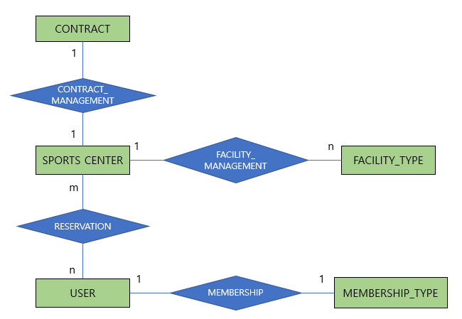
5.E/R DIAGRAM

Slide 9
6.DATA DESIGN
FACILITY_TYPE(F_ID, F_TYPE)
FACILITY_MANAGEMENT(C_ID, F_ID)
MEMBERSHIP(U_ID, M_TYPE)
MEMBERSHIP_TYPE(M_TYPE, COURSE, COST)
USERS(U_ID, PASSWORD, FIRST_NAME, LAST_NAME, ADDRESS_1, ADDRESS_2, P_NUM)
RESERVATION(R_ID, START, END, PEOPLE, F_ID, C_ID, U_ID)
CENTER(C_ID, C_NAME, C_NUM, ADDRESS_1, ADDRESS_2, OPEN, CLOSE)
CONTRACT_MANAGEMENT(C_ID, CON_NUM)
CONTRACT(CON_NUM, START_DATE, END_DATE)

Slide 10
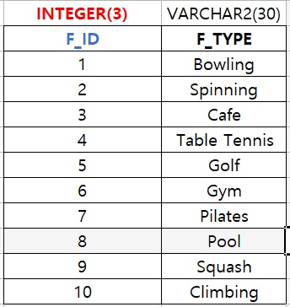
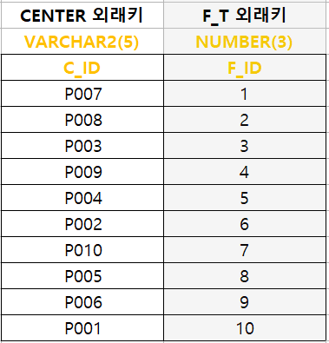
6.DATA DESIGN
FACILITY_TYPE
FACILITY_MANAGEMENT

Slide 11
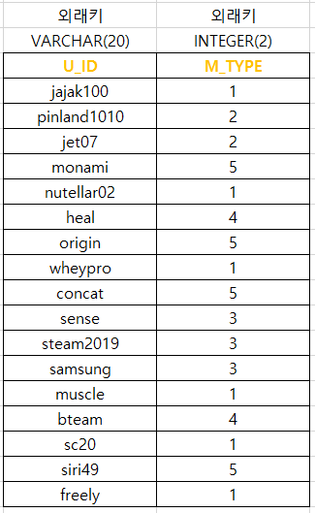
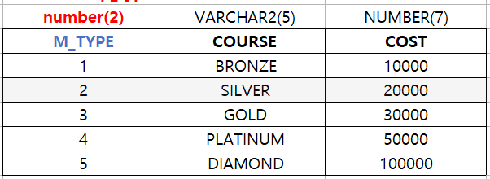
6.DATA DESIGN
MEMBERSHIP
MEMBERSHIIP_TYPE

Slide 12
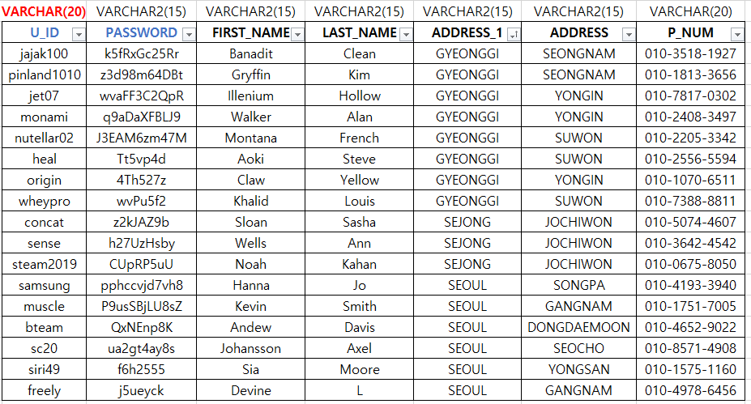
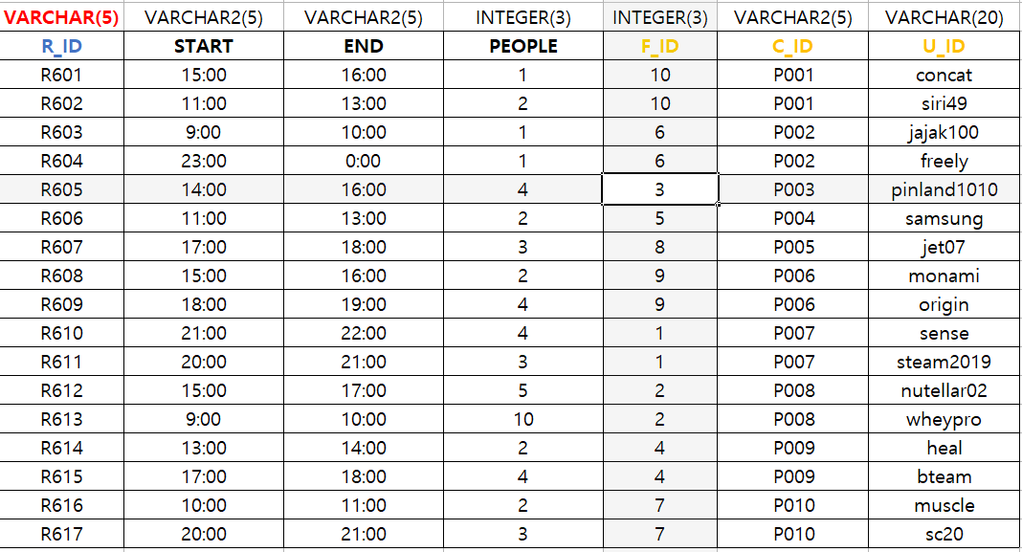
6.DATA DESIGN
USERS
RESERVATION

Slide 13
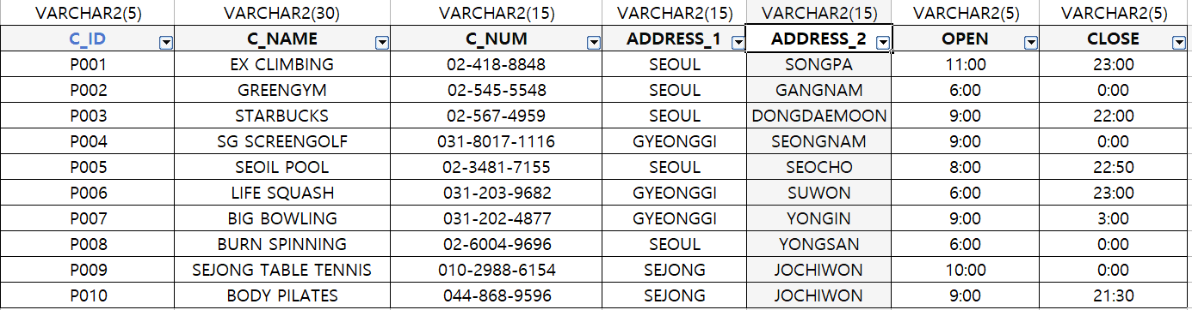
6.DATA DESIGN
CENTER

Slide 14
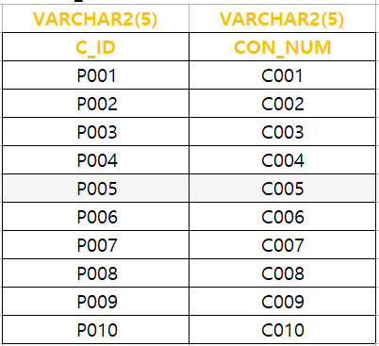
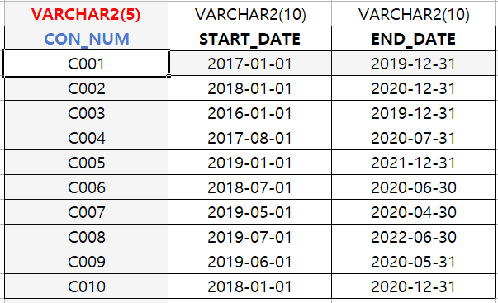
6.DATA DESIGN
CONTRACT_MANAGEMENT
CONTRACT

Slide 15
7.FUNCTION DEPENDENCY
Users Table
U_ID → {phone_number }
Membership Table
M_ID → { Course, Cost }
Center Table
C_ID → { c_name, center_number }
Facility Table
id → { type }
Contract Table
id → { name }

Slide 16
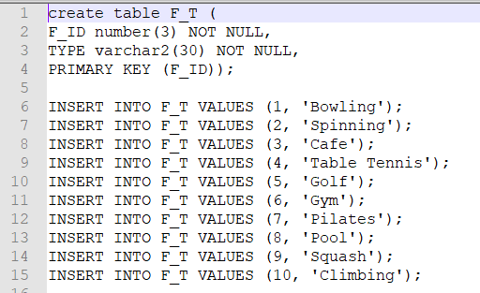
8.CREATE & INSERT

Slide 17
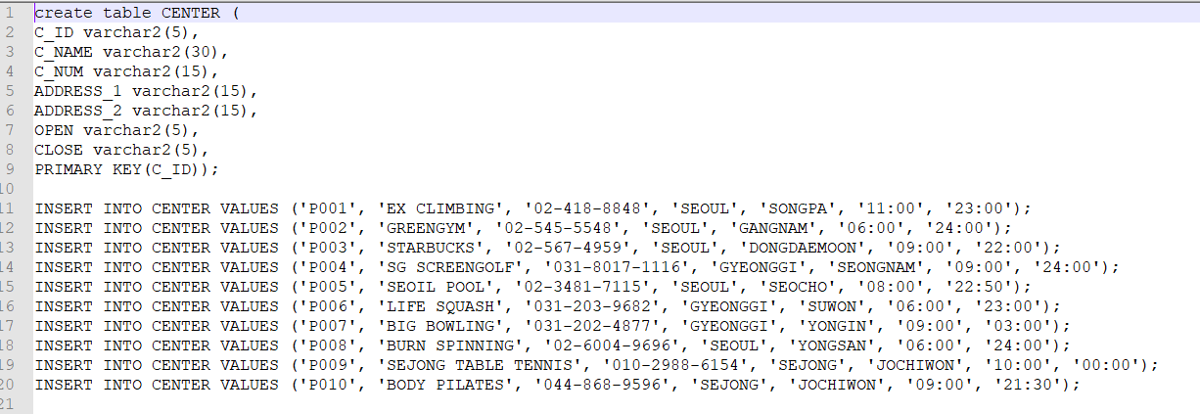
8.CREATE & INSERT

Slide 18
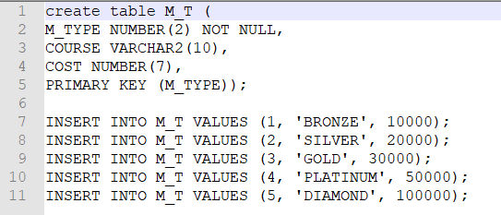
8.CREATE & INSERT

Slide 19
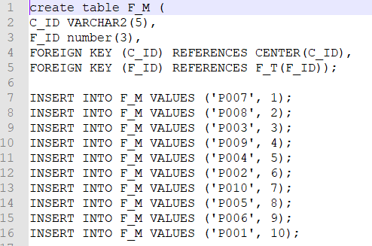
8.CREATE & INSERT

Slide 20
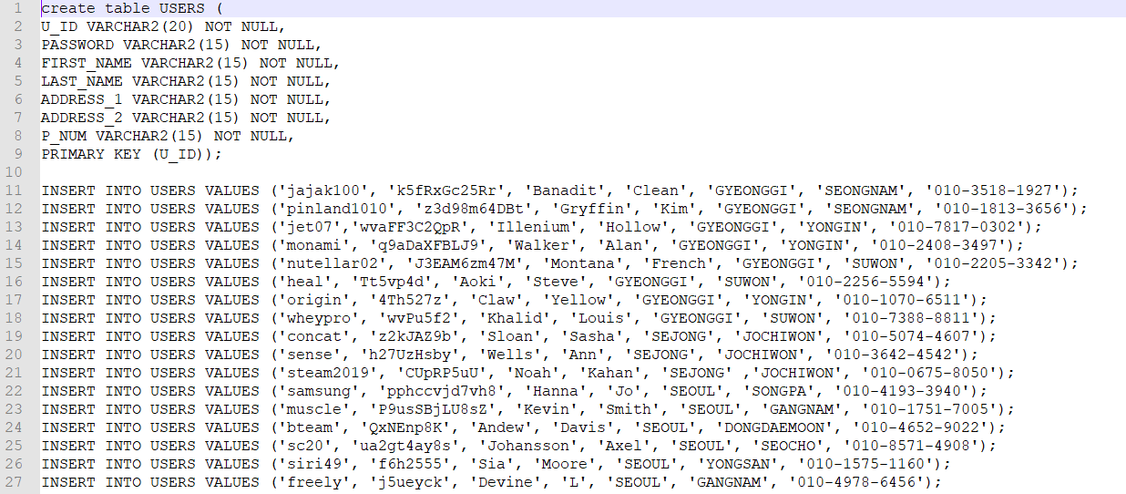
8.CREATE & INSERT

Slide 21
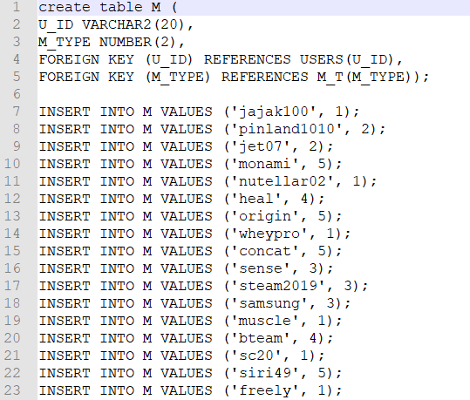
8.CREATE & INSERT

Slide 22
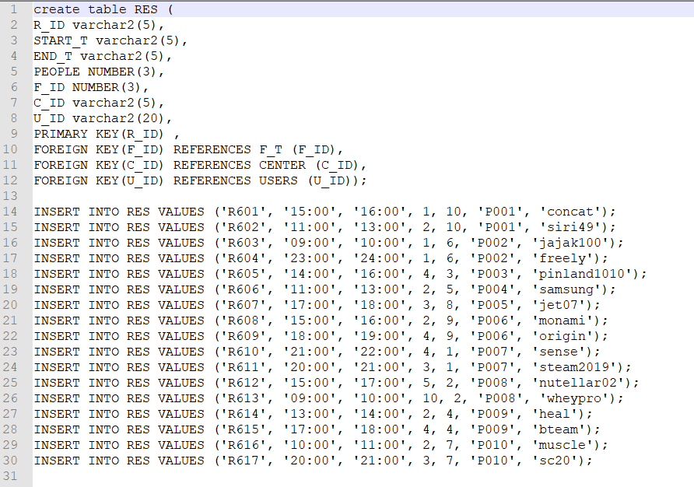
8.CREATE & INSERT

Slide 23
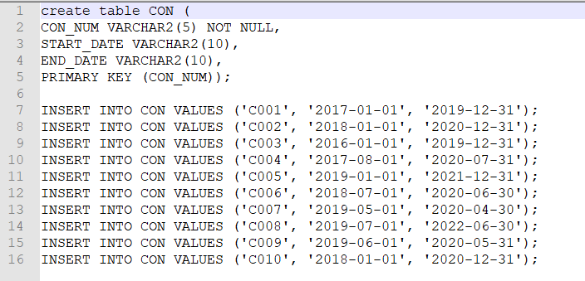
8.CREATE & INSERT

Slide 24
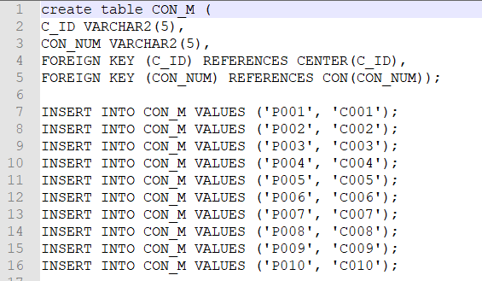
8.CREATE & INSERT

Slide 25
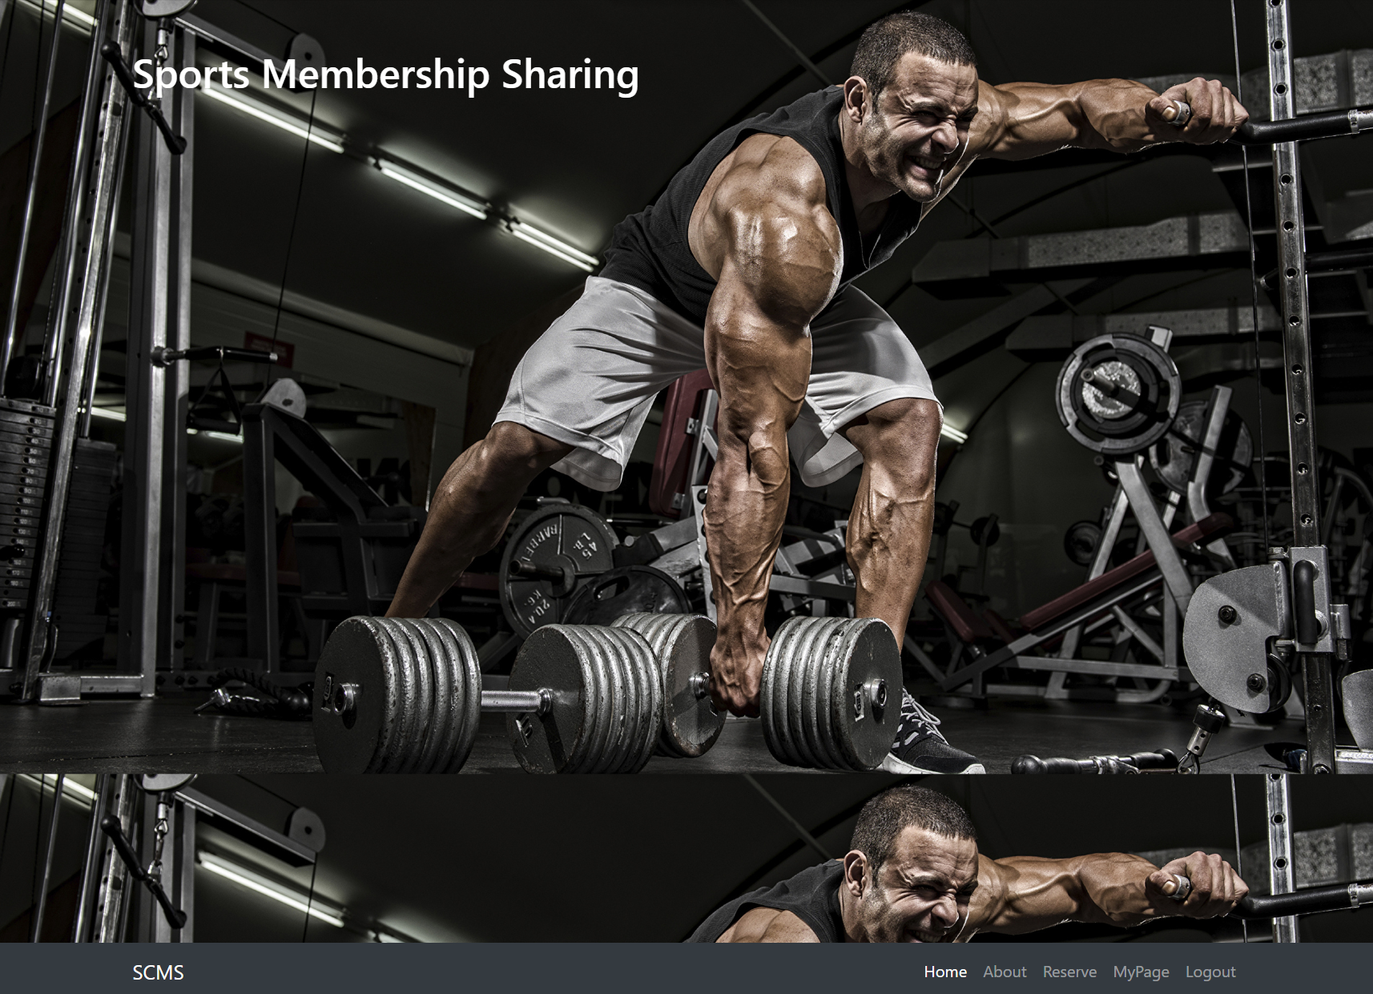
9.ORGANIZATION

Slide 26
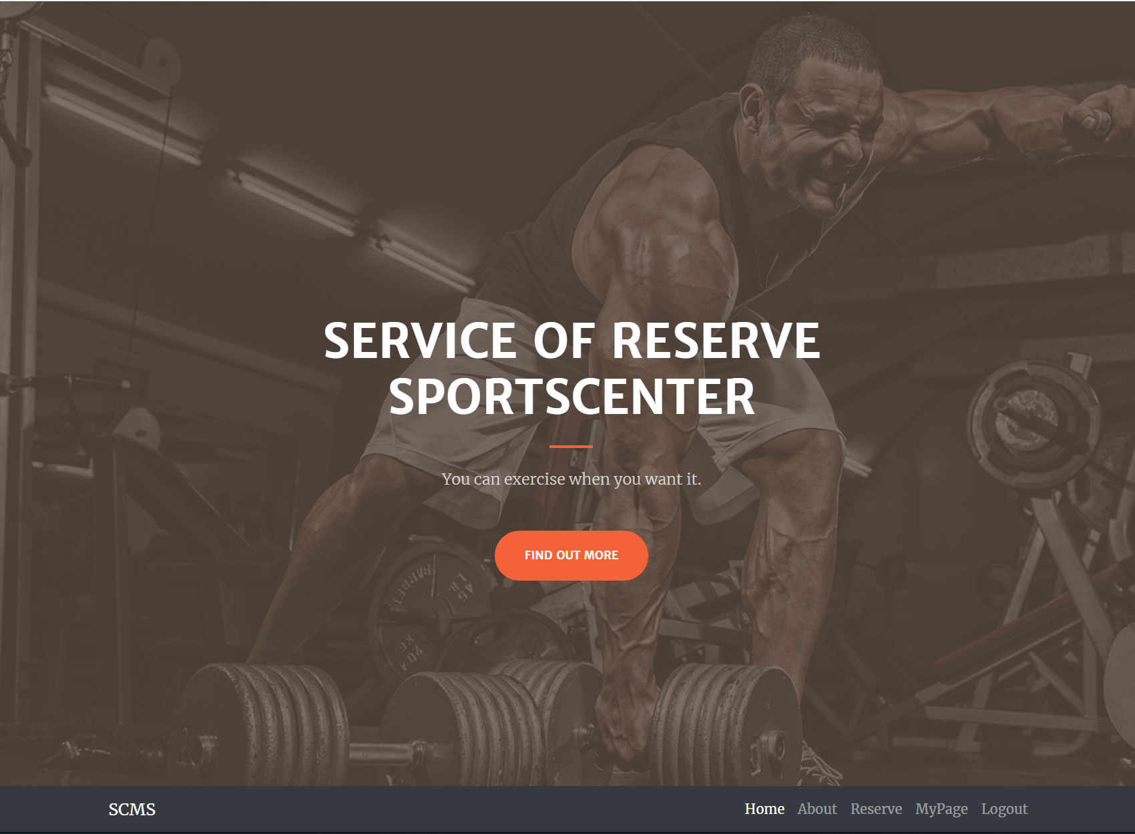
9.ORGANIZATION

Slide 27
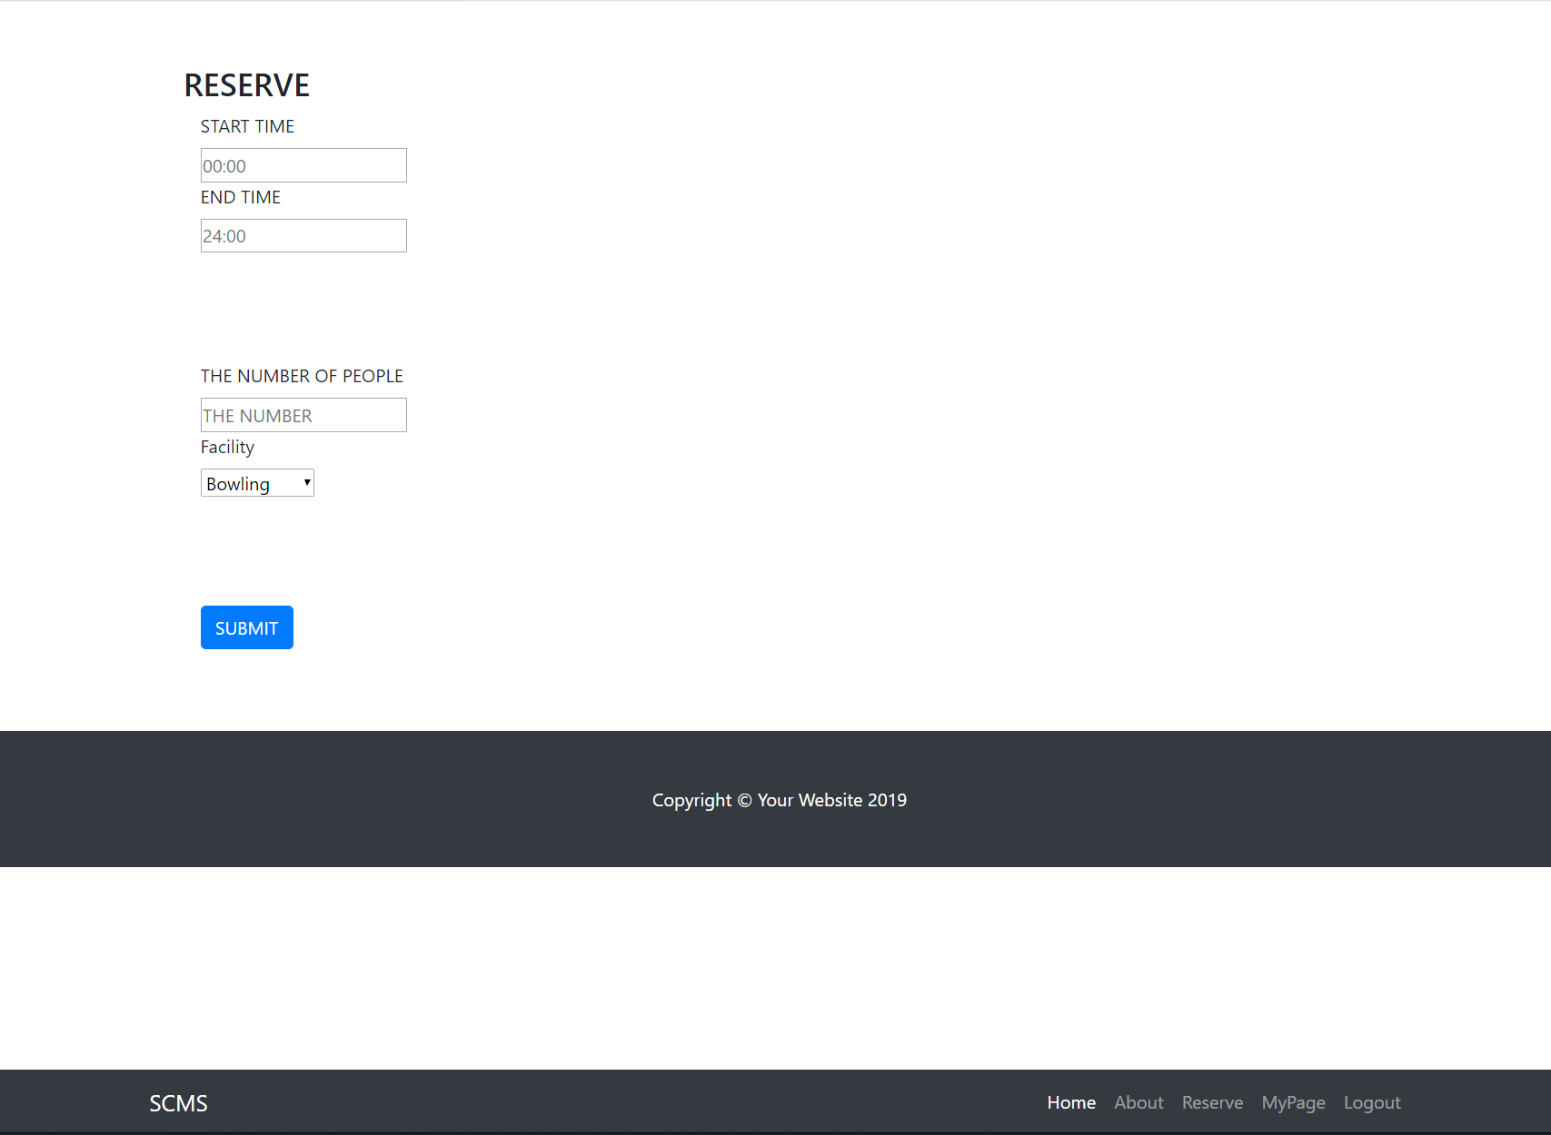
9.ORGANIZATION

Slide 28
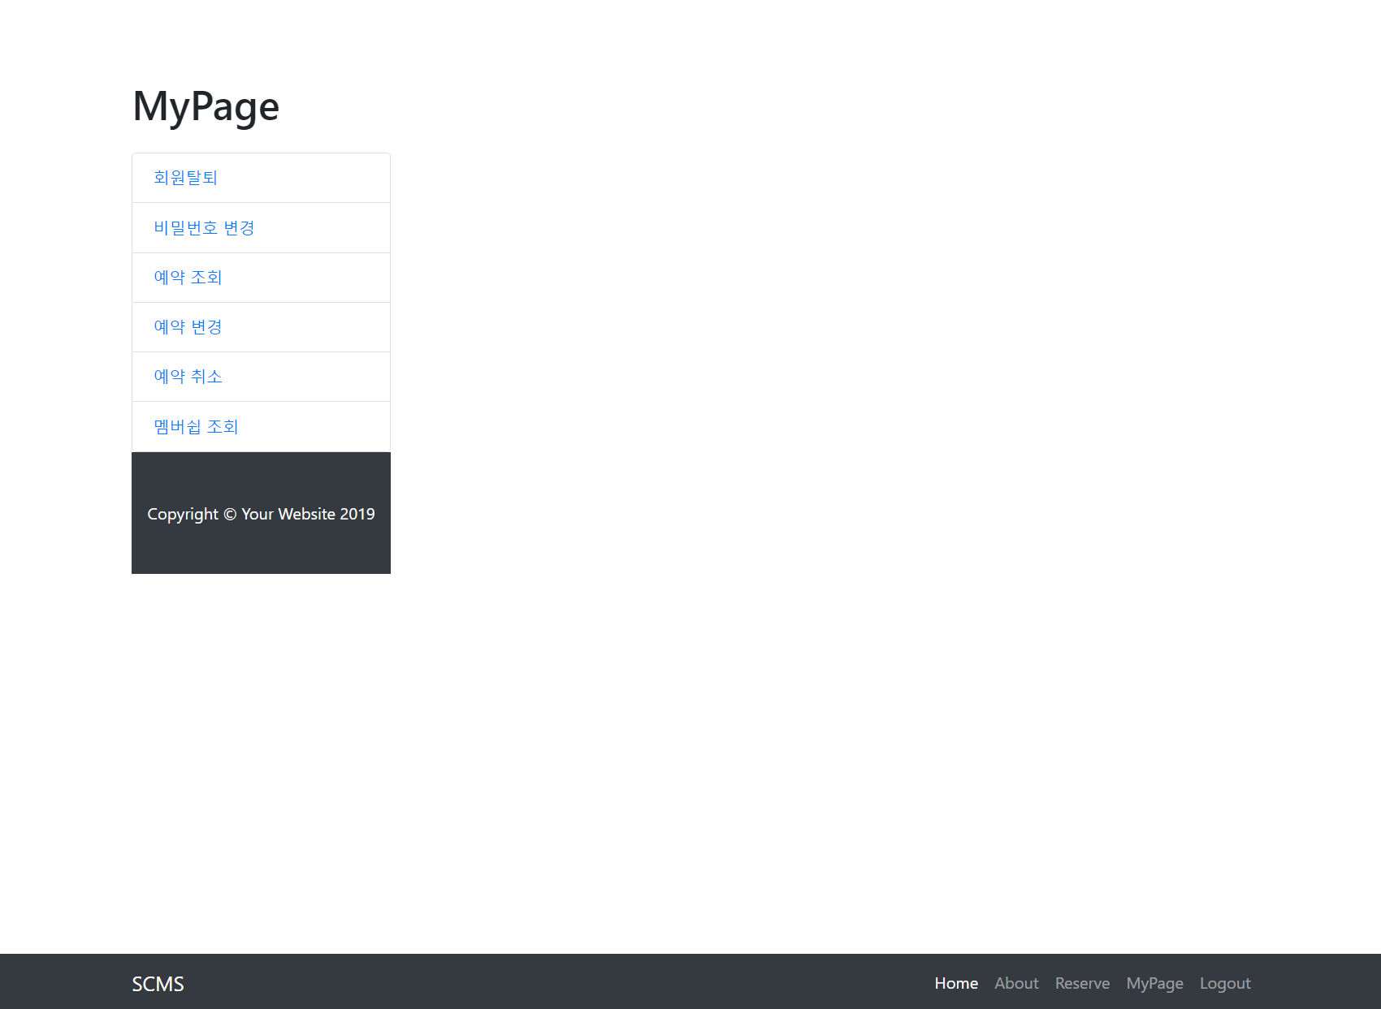
9.ORGANIZATION

Slide 29
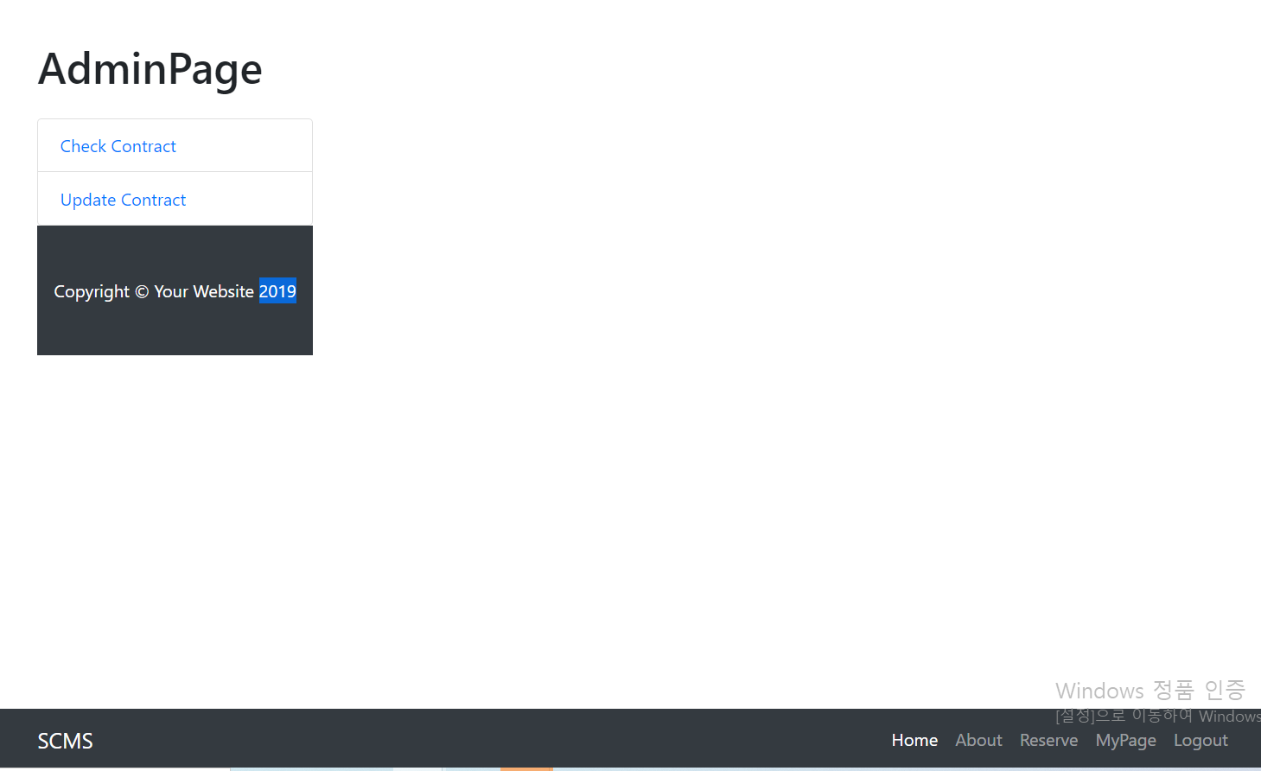
9.ORGANIZATION

Slide 30
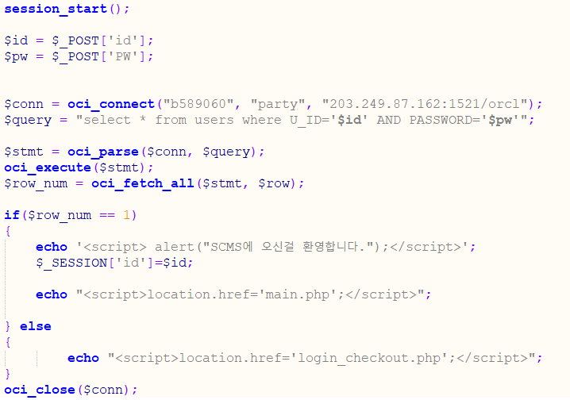
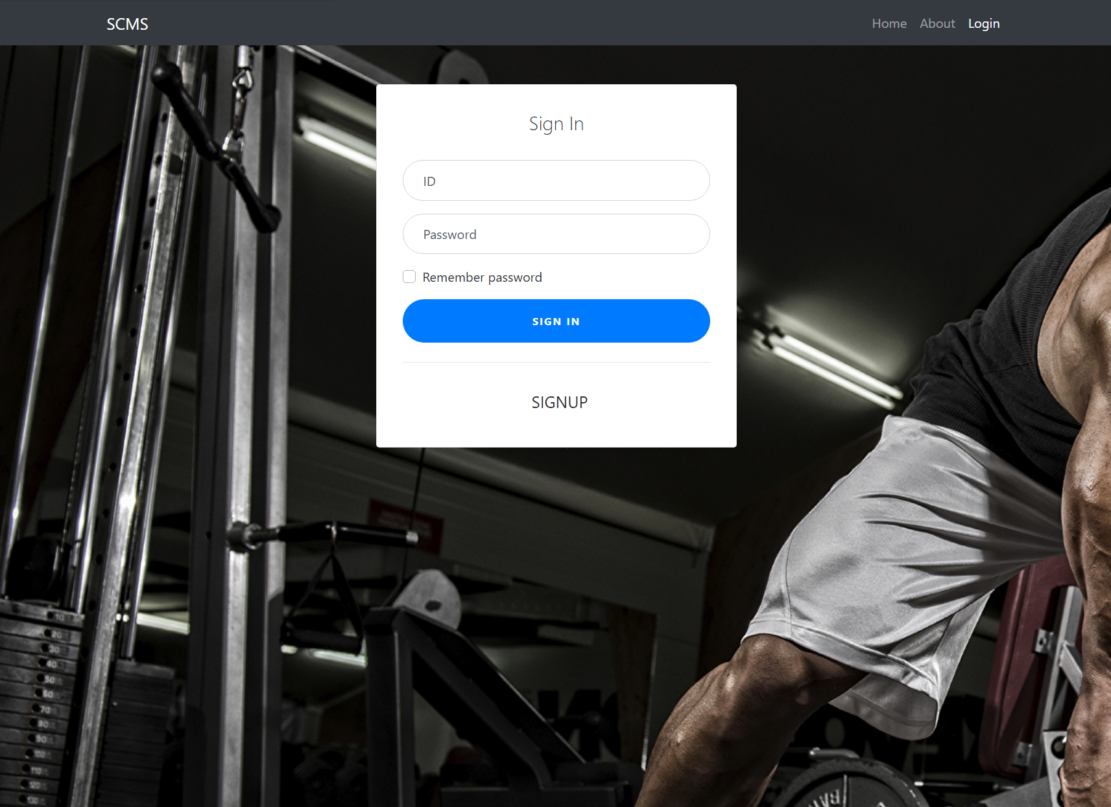
10.QUERIES
Login

Slide 31
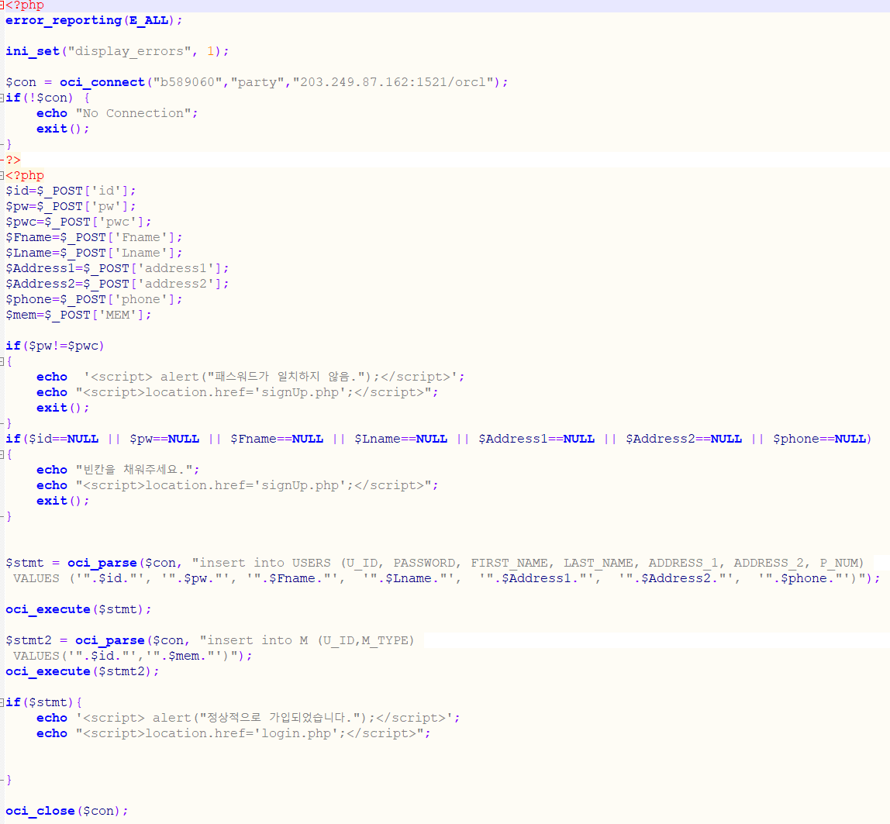
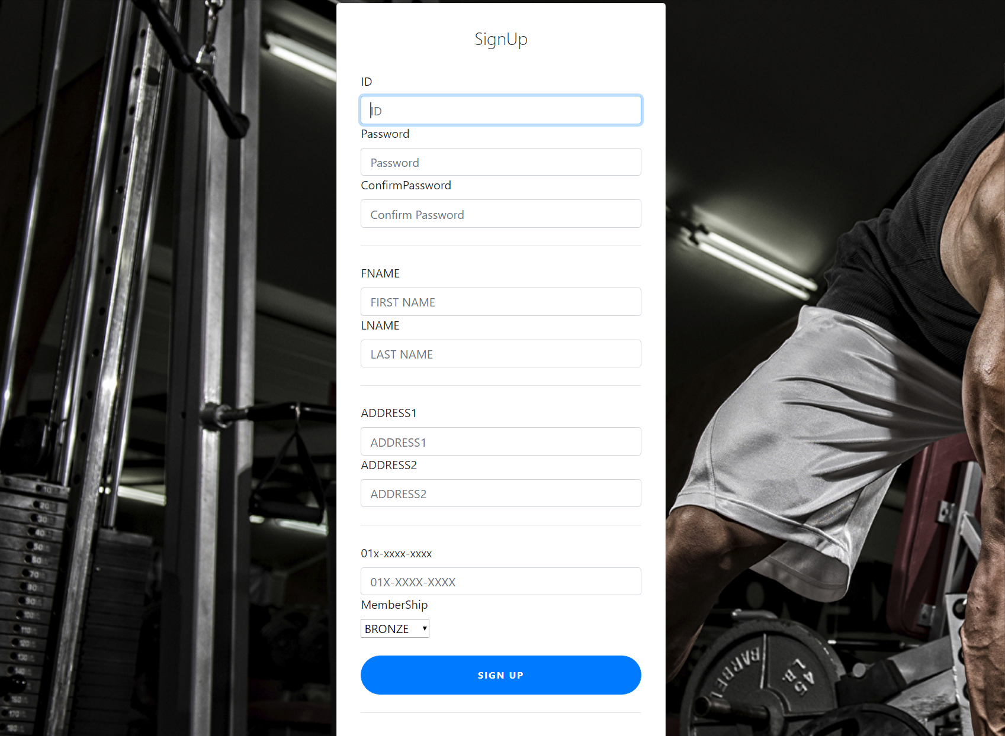
10.QUERIES
Insert

Slide 32
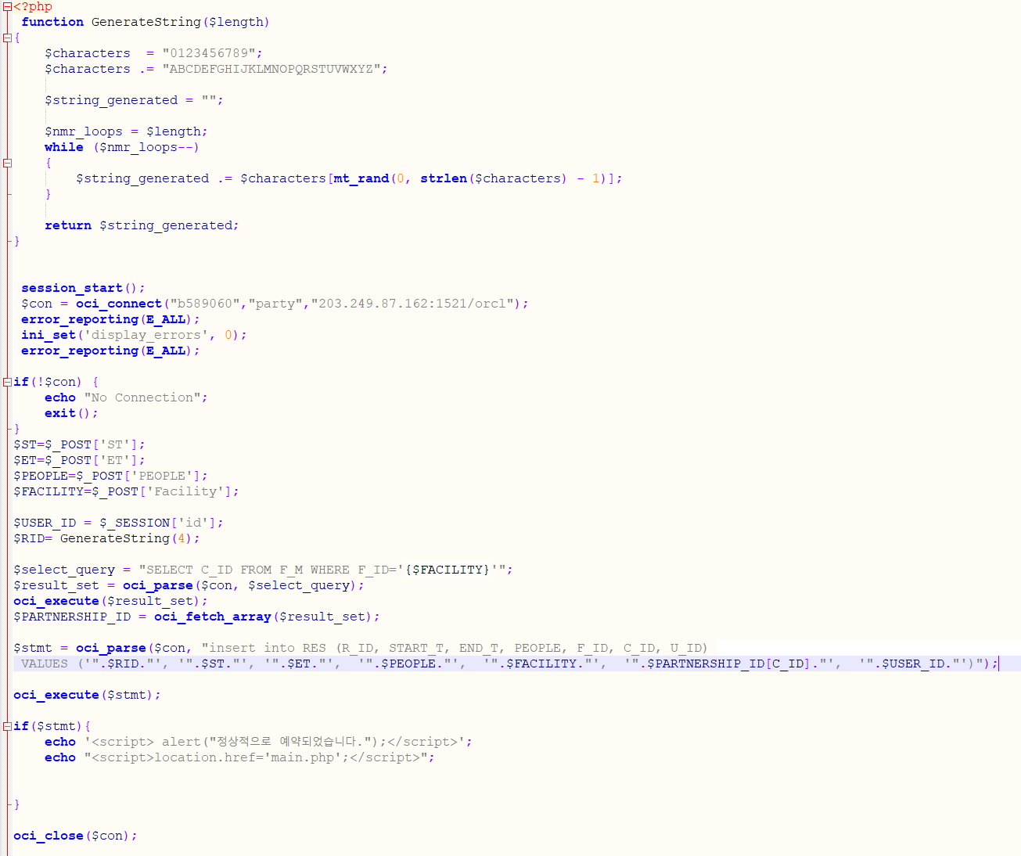
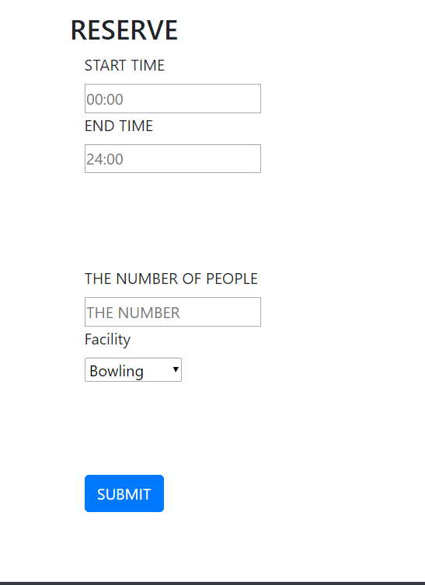
10.QUERIES
Reserve

Slide 33
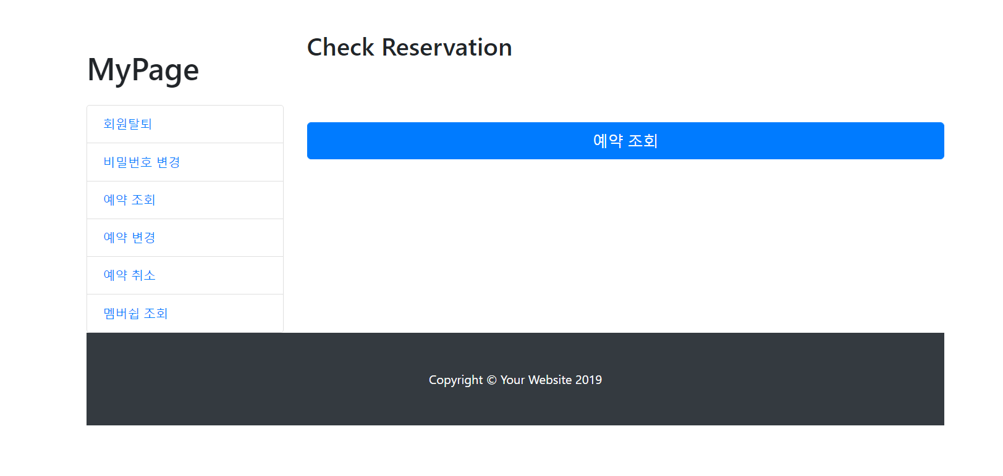
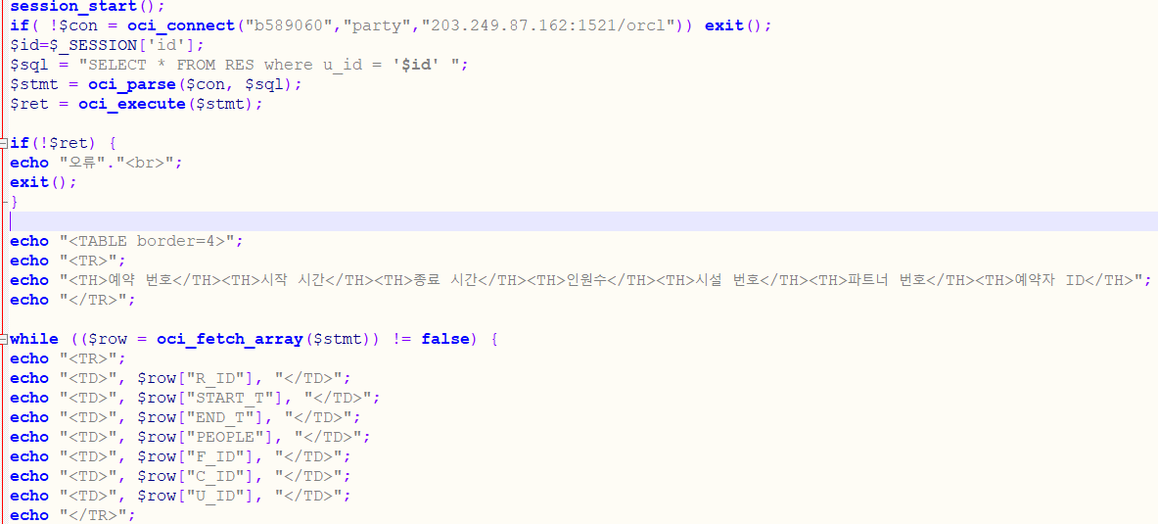
10.QUERIES
Reserve_Select

Slide 34
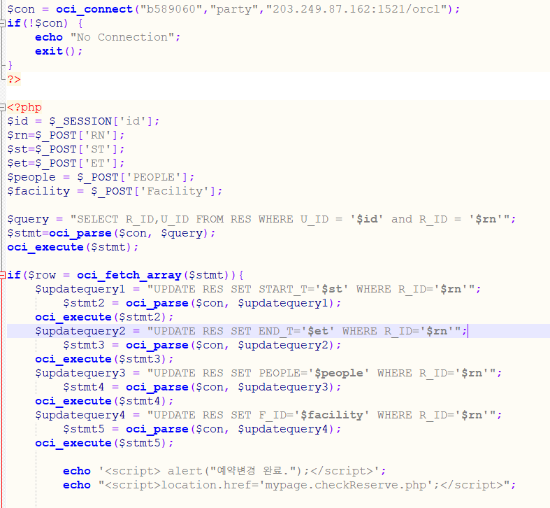
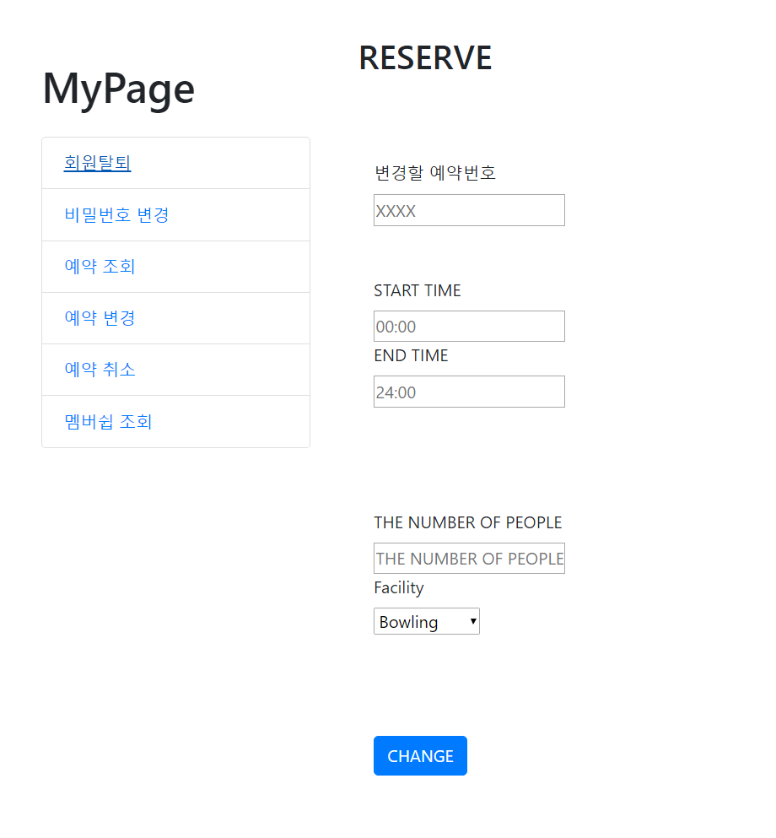
10.QUERIES
Reserve_Update

Slide 35
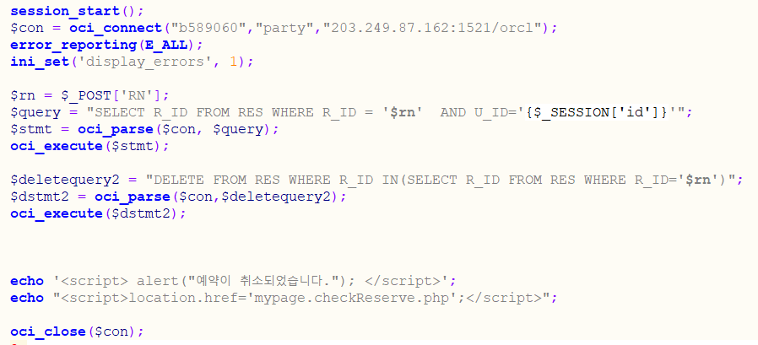
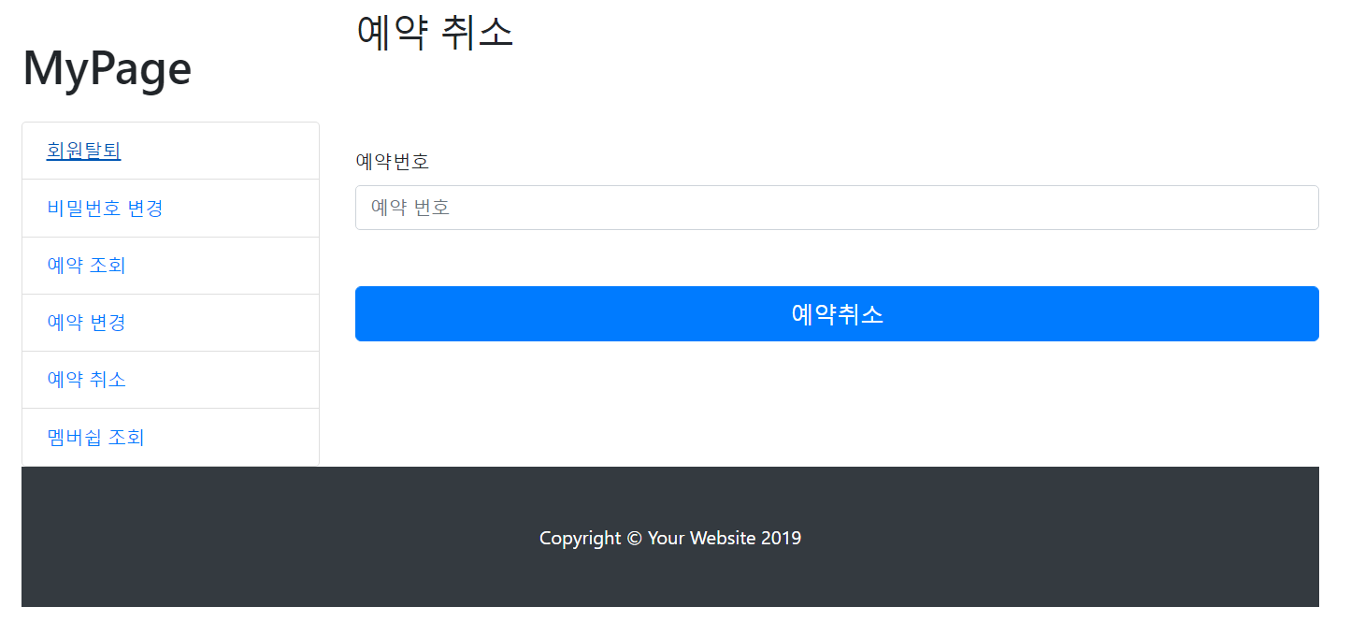
10.QUERIES
Reserve_Delete

Slide 36
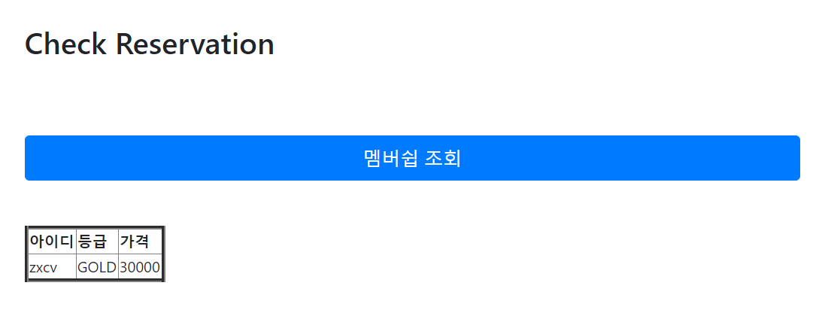
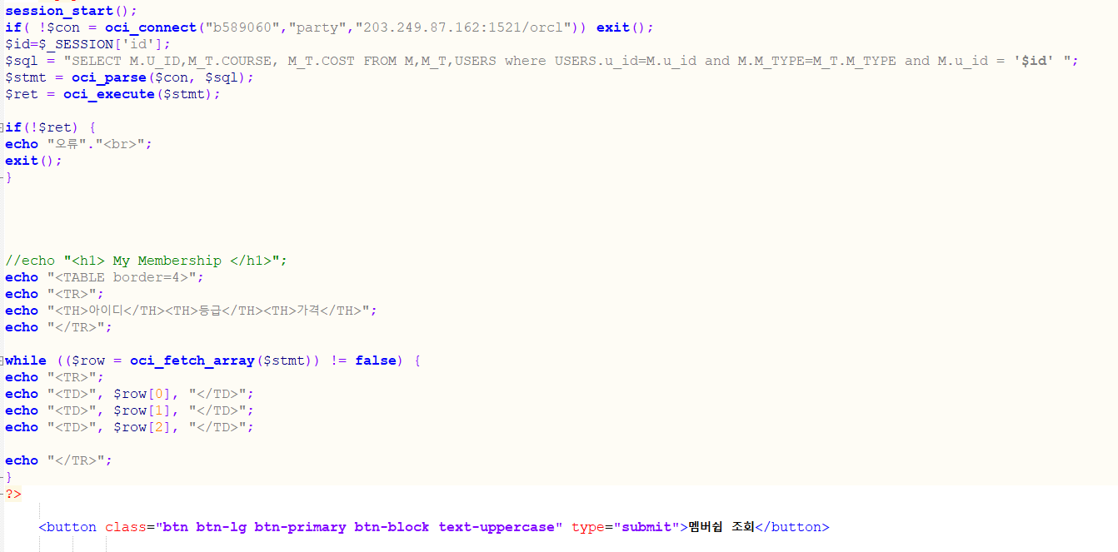
10.QUERIES
Membership_Select

Slide 37
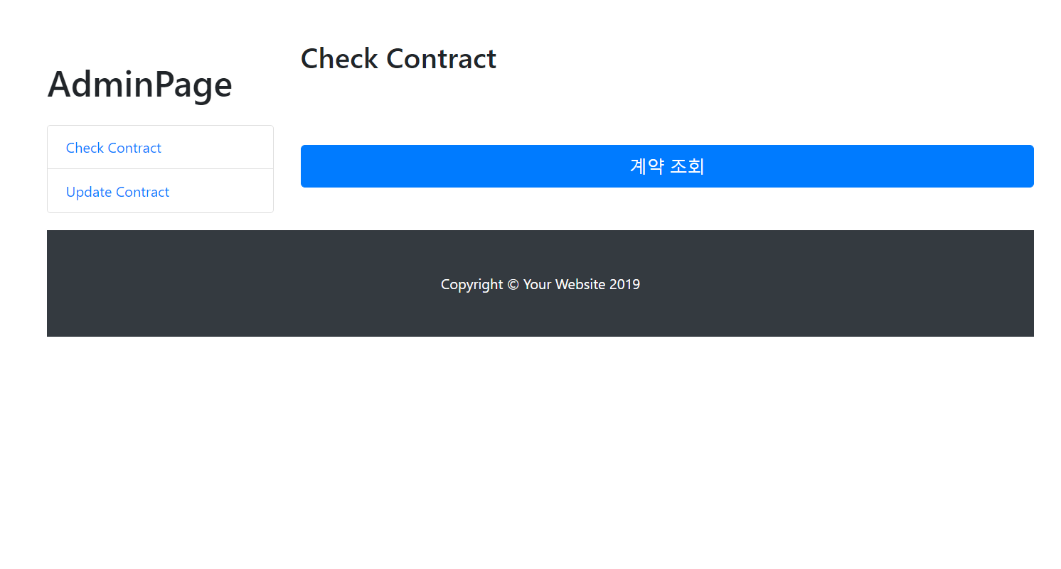
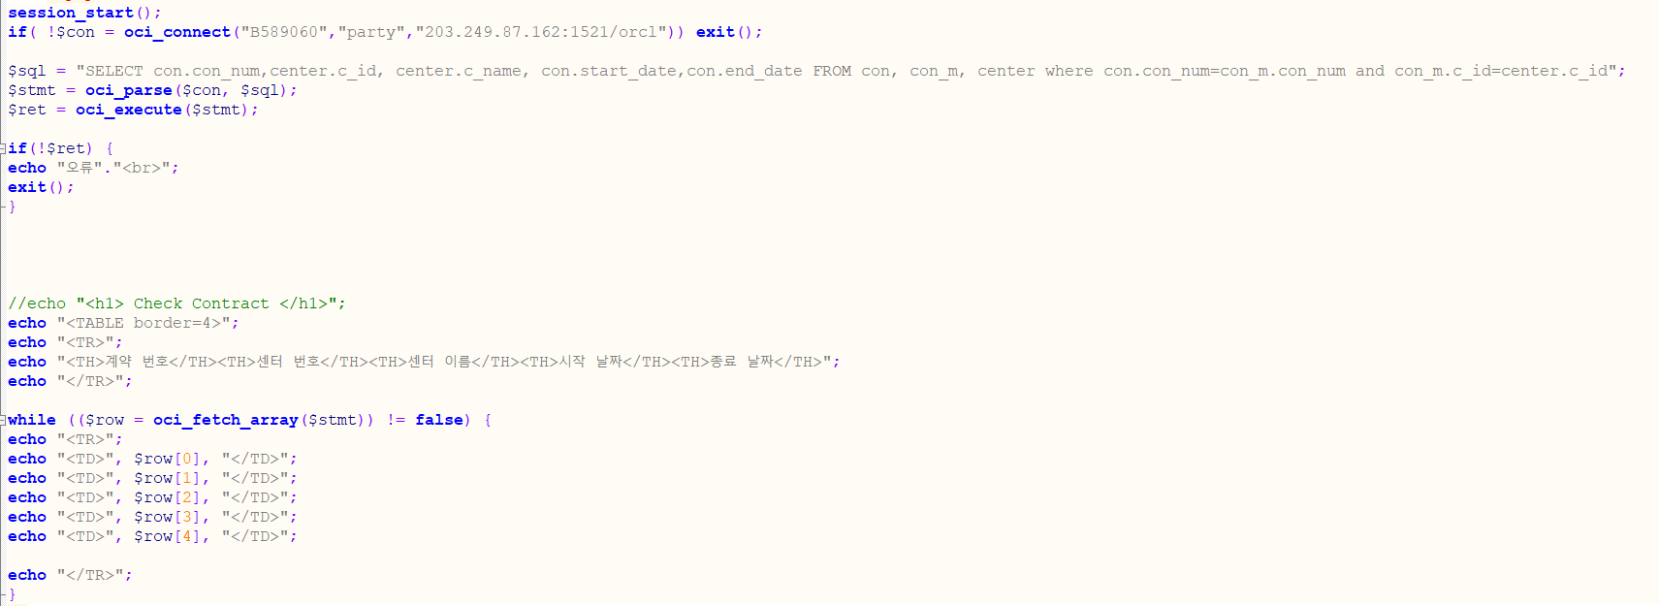
10.QUERIES
Contract_Select

Slide 38
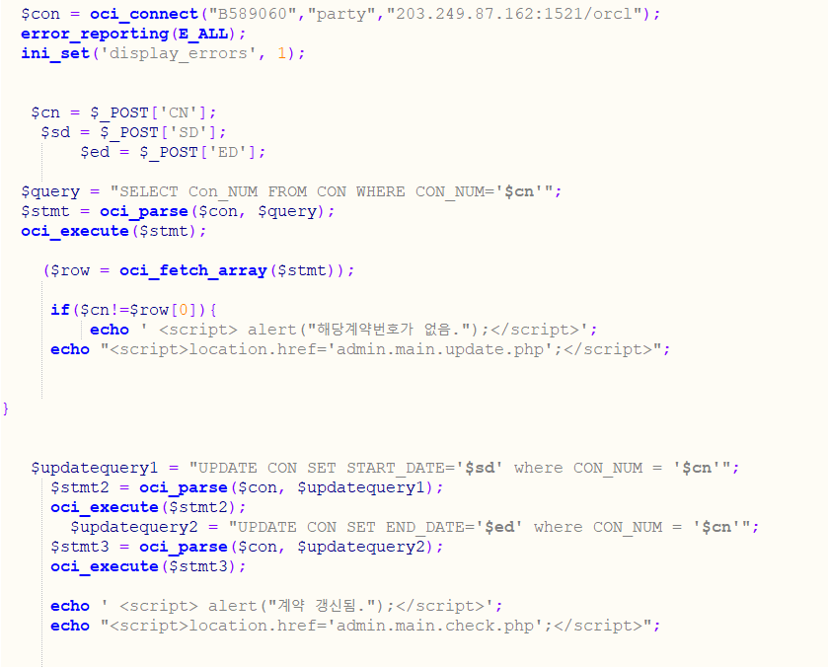
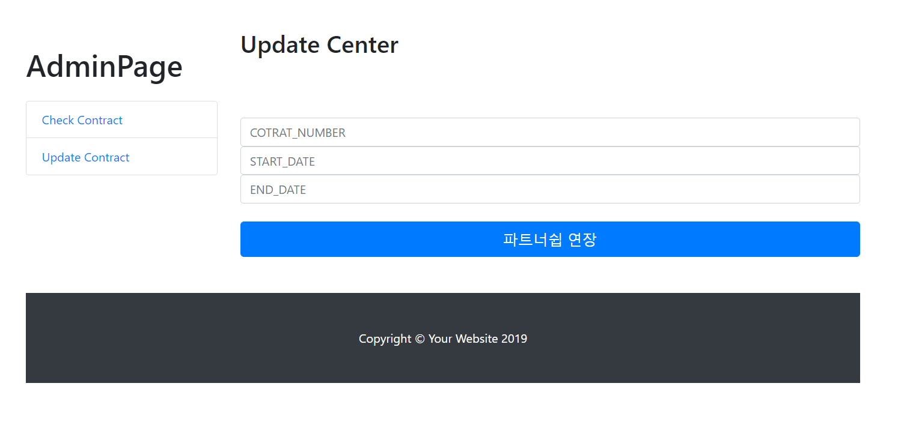
10.QUERIES
Contract_update

Slide 39

11.HOW TO USE

Slide 40
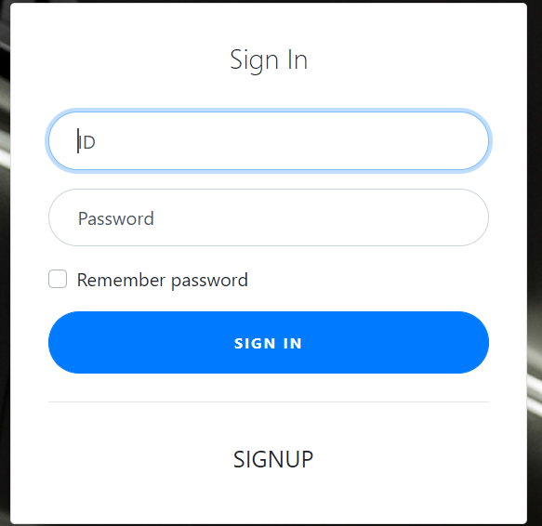
11.HOW TO USE

Slide 41
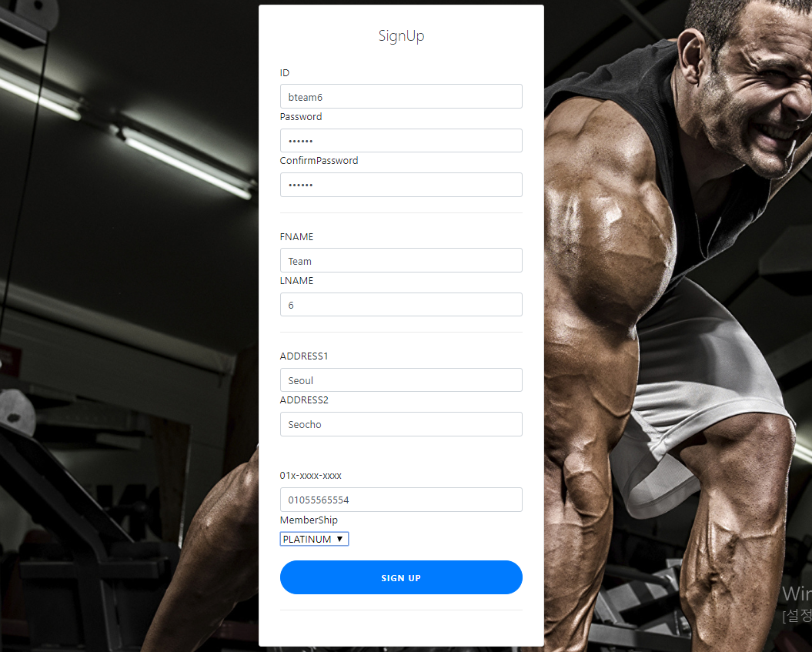
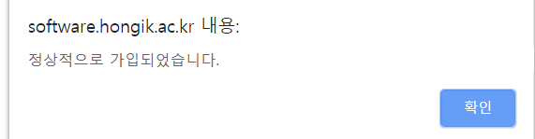
11.HOW TO USE

Slide 42
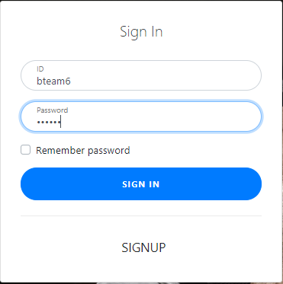
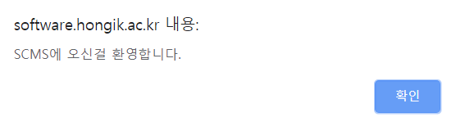
11.HOW TO USE

Slide 43
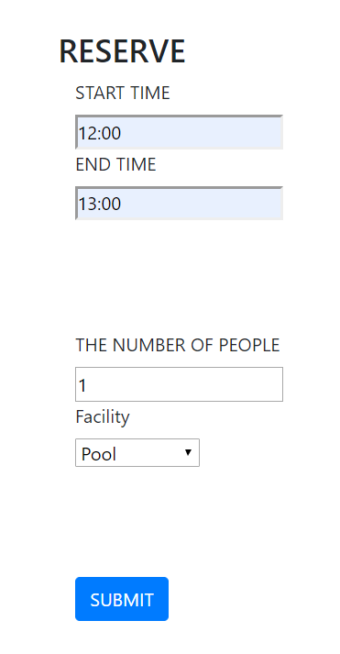
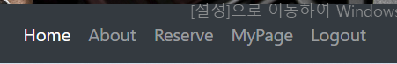
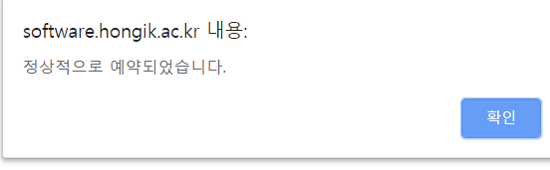
11.HOW TO USE

Slide 44


11.HOW TO USE

Slide 45



11.HOW TO USE

Slide 46



11.HOW TO USE

Slide 47

11.HOW TO USE

Slide 48


11.HOW TO USE

Slide 49

11.HOW TO USE

Slide 50



11.HOW TO USE

Slide 51
12.TEST
http://software.hongik.ac.kr/b_team/b_team6/final_project_51/

Slide 52
13.WHAT WE LEARNED
1. Long Query Error
2. Benefits of Membership
3. Information of Regions
4. Record System

